Slide 1
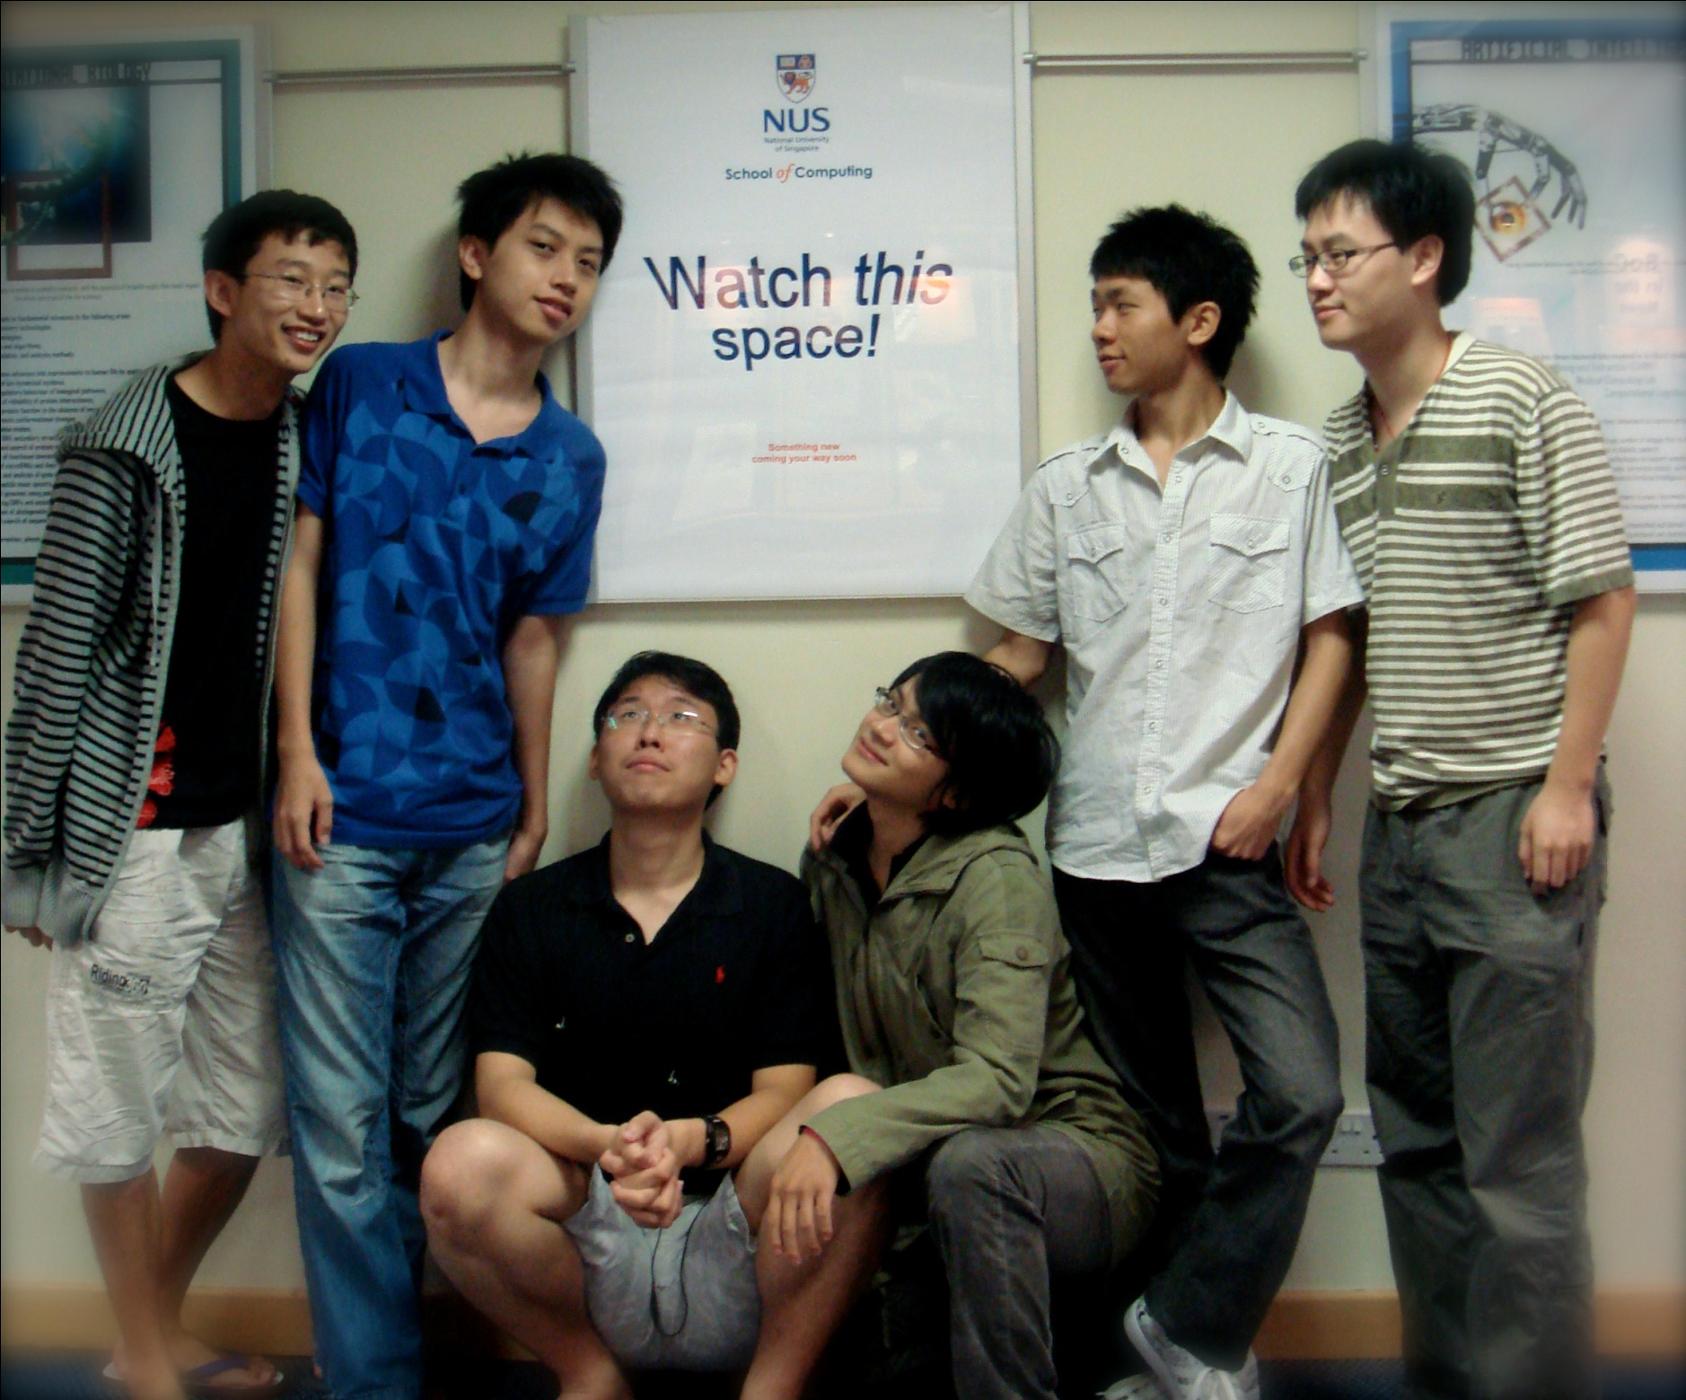
How to work individually effectively in a team setting
Lessons learnt from CS3215
Lightning Talk
0110

Slide 2
Disadvantaged != Excuse for doing less work

Slide 3








Slide 4
Know your team
Know when to be a leader, when to be a follower
Help one another out
Be aware of the overall status of the product
Be independent
Be prepared to step out of your comfort zone
You are part of the group, the group is not part of you
Enjoy the process!

Slide 5
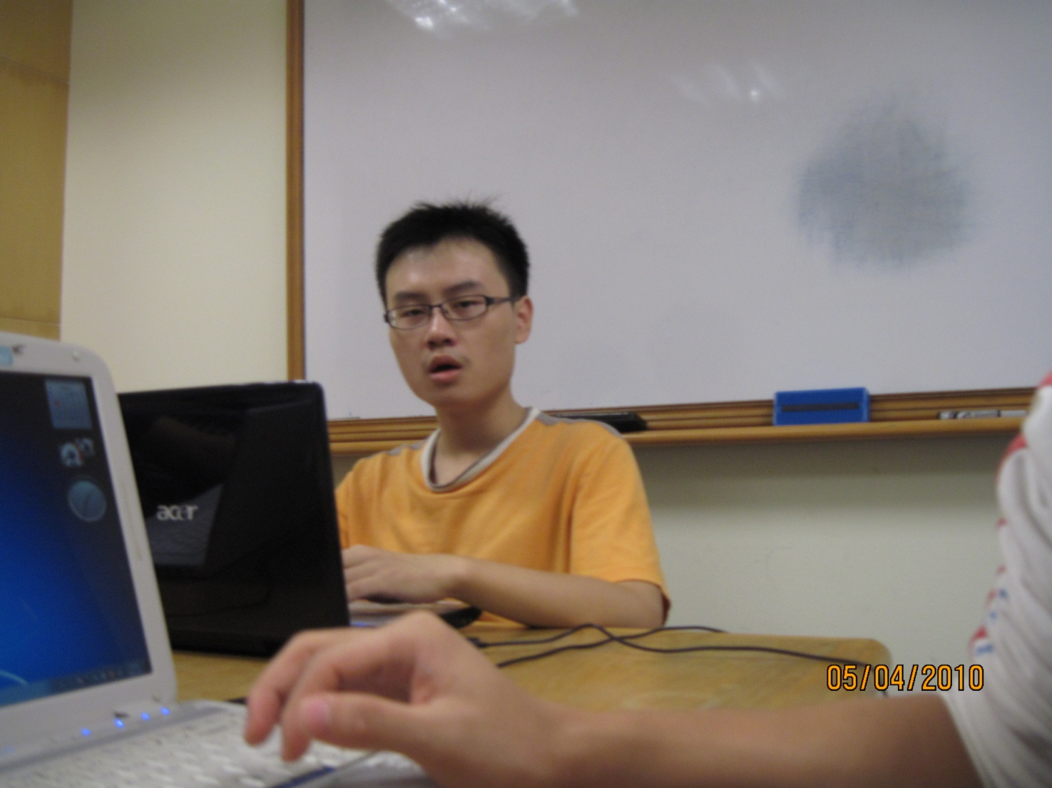
Be aware of the overall status of the product
Next deadline?
Current version?
GUI?
Documentation?
Any critical bugs not solved?
Outstanding issues?
Lightning talk??
?
?
?

